Slide 1
Physical computing Environmental + Kiosk
Channel Overview

Slide 2
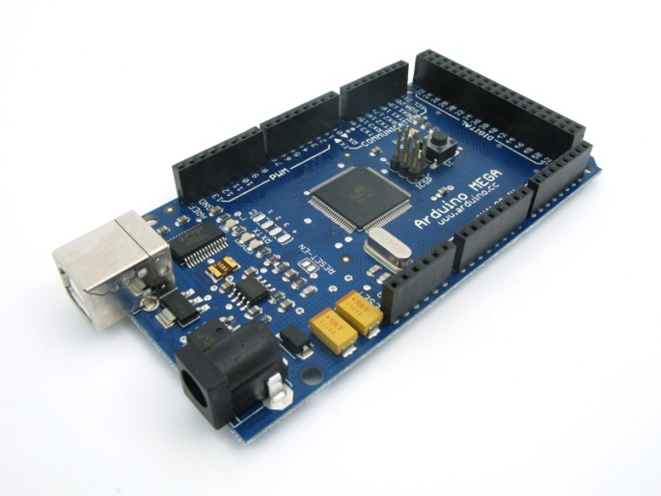
Channel Opportunity
Physical (or embedded) computing
Hardware
Arduino
Console Accessories
WiiMotes
Kinect
Software
Processing (Java)
Flash
C#
Engage interaction of analog devices
Translate input to software
Add dimension and depth to applications
Creations using MIDI, musical instruments, lighting, sensors, etc
Notes:
Physical (or embedded) computing: interactive physical systems by the use of software and hardware that engage in an analog environment.

Slide 3
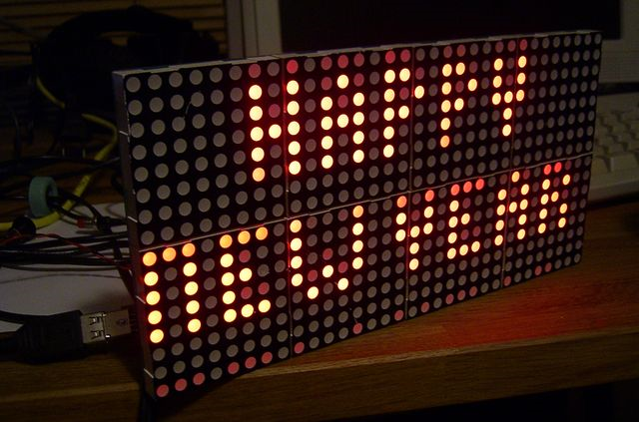
Example 1- LED Matrix
Requires Dot Matrix LED Display(s)
Deployed to hardware once
Simple and effective
Ubiquitous display
Notes:
Image Source: http://retrointerfacing.com/WP/wp-content/uploads/2008/12/display.jpg

Slide 4
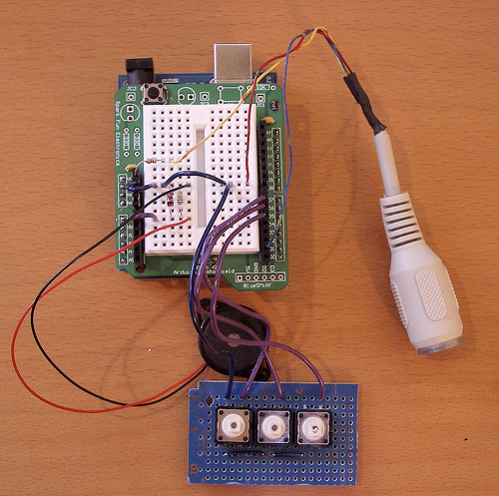
Example 2- MIDI Controller
Use sensors to trigger sounds
Add rotary knobs to tweak effects
Leverage idea to build synthesizers, drum machines, guitar pedals
Notes:
Image Source: http://www.flickr.com/photos/todbot/283347417/

Slide 5
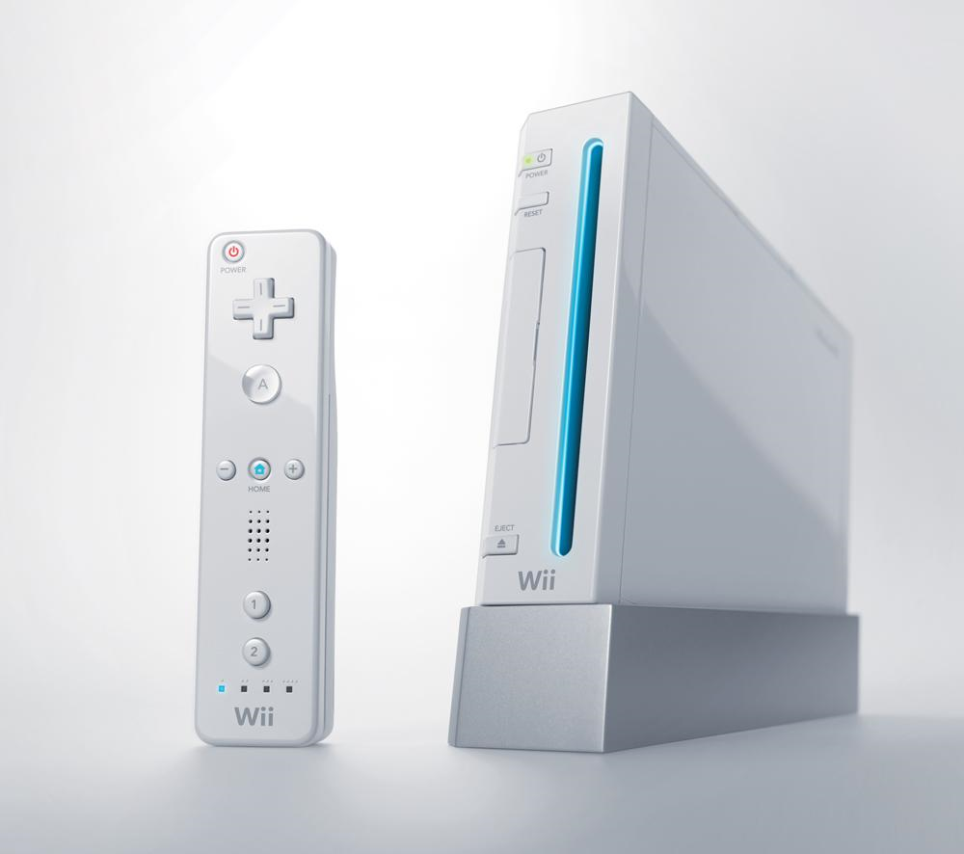
Example 3- Game Console
Most known type of physical computing
Hardware (controller) tells software how to behave
Familiar environment and controls
Console Hardware can be repurposed
Wiimotes
Xbox Kinect
Notes:
Image Source: http://www.hexbyte.com/wii.jpg

Slide 6
Major Technologies
Things BLITZ Knows
Flash
C#
Things BLITZ Doesn’t Know
Processing
Java
Electrical Wiring
Notes:
Flash to interact with hardware is typically done via USB, which requires a socket connection. This implementation is cumbersome. However, libraries are available to help developers get started.
C# to interact with hardware is typically done via COM Ports.
http://wiring.org.co/ - teaches users how to program microcontrollers

Slide 7
Arduino (Hardware)
Open-source prototyping platform
Arduino Features
Microcontroller boards inexpensive
Communication simplified with Processing, Flash, and C#
Arduino Challenges
Requires thorough understanding of electrical wiring
Add-on and complement devices expensive

Slide 8
Processing (Software)
The Good
Free, open source
Builds Applets for web and standalone
Runs on Mac, Windows, Linux
Simplifies Java’s graphical capabilities
The Bad
User needs Java runtime plugin installed
Notes:
Processing is an open source programming language and IDE. It is typically used for visual design.
John Resig (jQuery) port for Javascript: http://processingjs.org/

Slide 9

Repurposing Console Accessories
Wiimotes have been hacked significantly for other purposes
See Adobe MAX Wall
Xbox Kinect
Hacking Kinect to work as PC input currently underway
BLITZ has an Xbox Developer license allowing us to develop using the native APIs

Slide 10
Thoughts?
What Industries / Clients does this work for?
Ones wishing to break away from point and click interactions
Any Ideas?
Mitsubishi driving immersion using Wii Wheel
Rover kiosk to educate users of products
Rock Band/Guitar Hero drums, guitar, DJ MIDI connections to create songs
Wii Balance Board -- ???

Slide 11
Additional Resources
http://labs.ideo.com/
http://tinker.it/now/
Arduino
I-Cube X
http://www.processing.org/
http://kinecthacks.net/
http://code.google.com/p/wiiflash/

